Slide 1
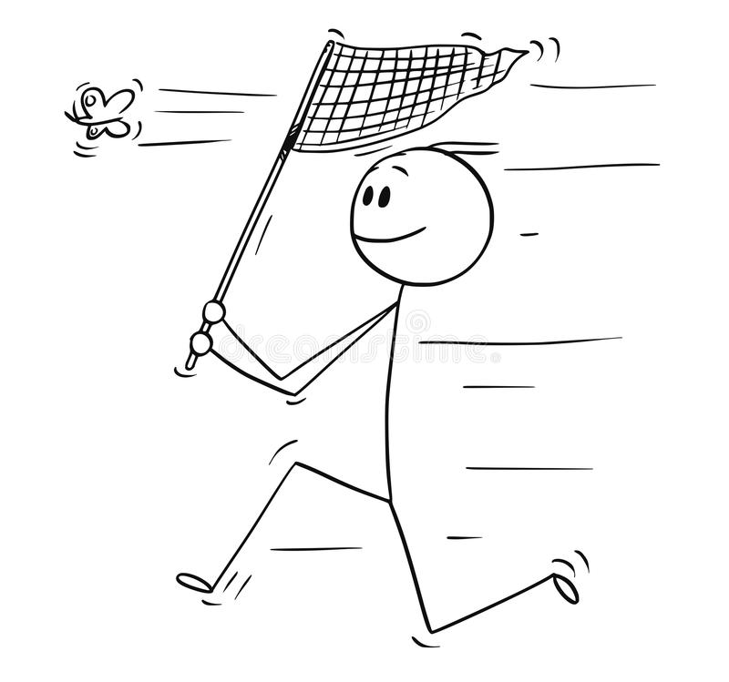
FIELD PREP 2022
Julian Wittische – Alain Frantz 2022
All photos are from Steven Falk https://www.flickr.com/photos/63075200@N07/collections/72157631518508520

Slide 2
Andrena cineraria – Summary
Males:
Males have denser white hairs on the side of the thorax but uniformly and more sparsely distributed white hairs on the dorsal part
Legs are thin and may some white hairs
Longer antennae, substantially larger that head width
Males are smaller and slimmer
Females:
Broad dorsal stripes of dense white/grey hair at the anterior and posterior parts of the thorax and black hair in between
Legs are thick and black
Shorter antennae, barely longer that head width

Slide 3
Andrena cineraria – Summary
A. cineraria:
Females have a shiny black abdomen
Females have black legs
A. vaga:
Females have patches of white hair
Females have patches of white hair on legs

Slide 4
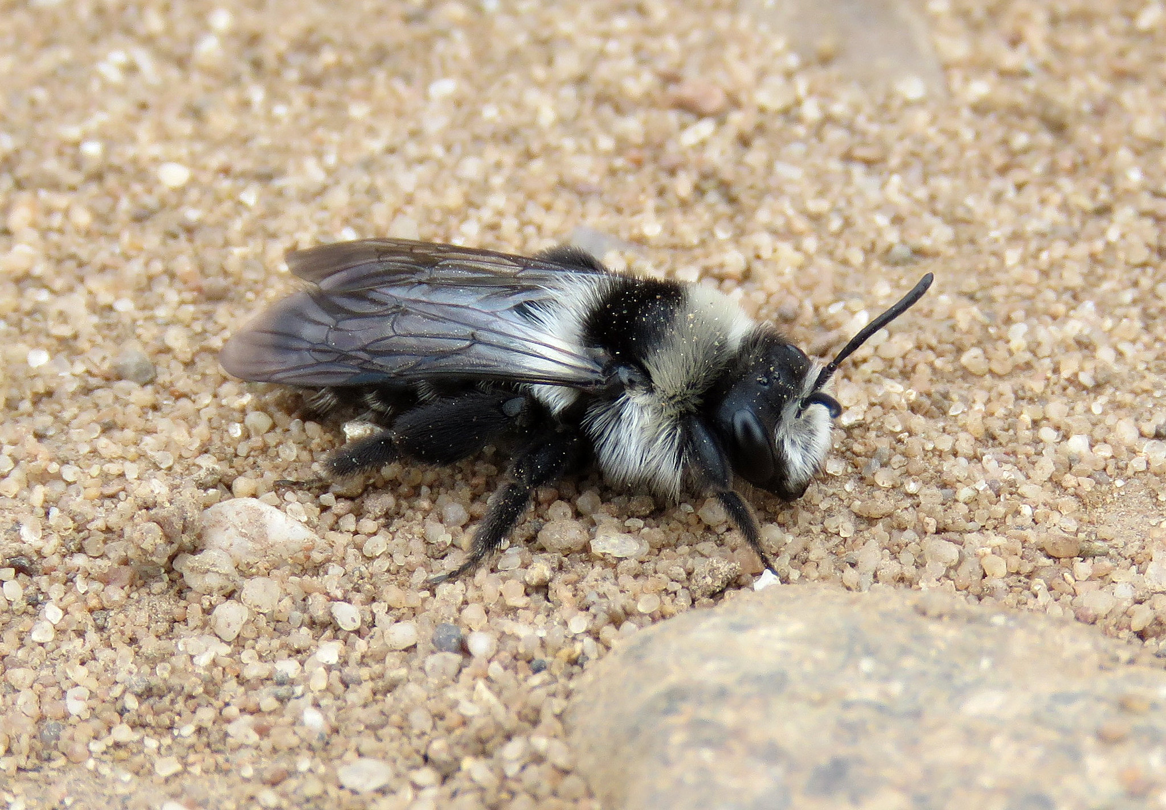
Andrena cineraria - Quiz

Slide 5
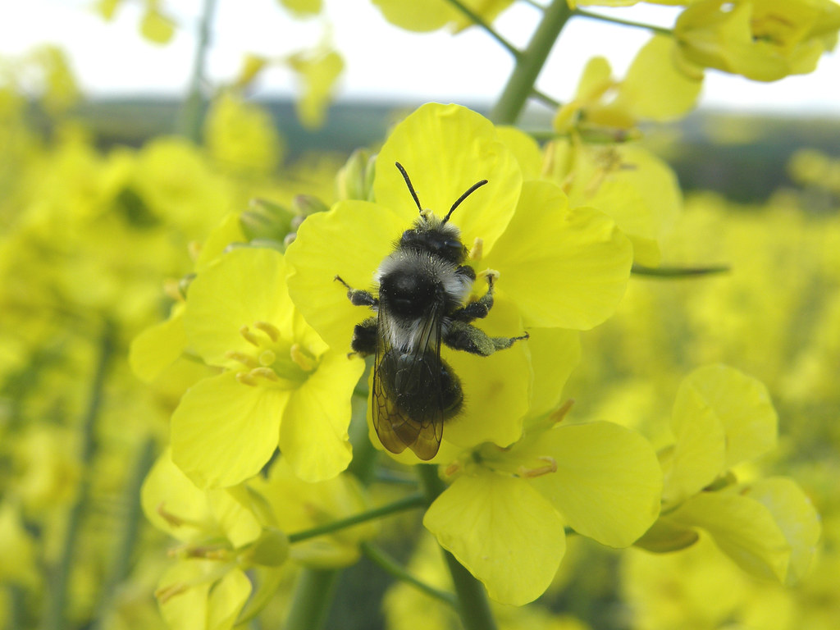
Andrena cineraria - Quiz

Slide 6
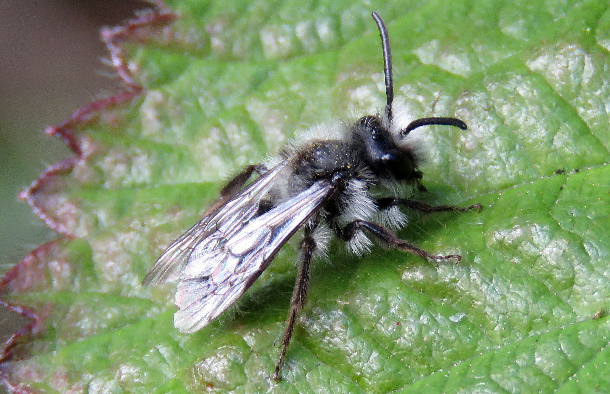
Andrena cineraria - Quiz

Slide 7
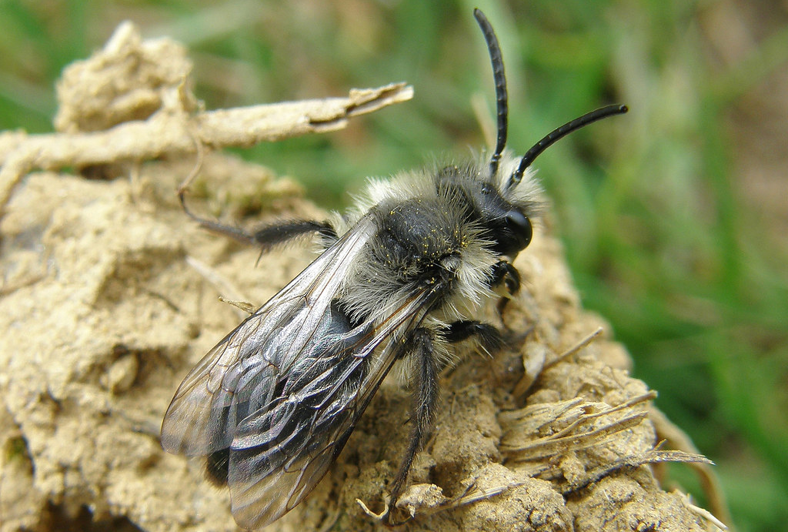
Andrena cineraria - Quiz

Slide 8
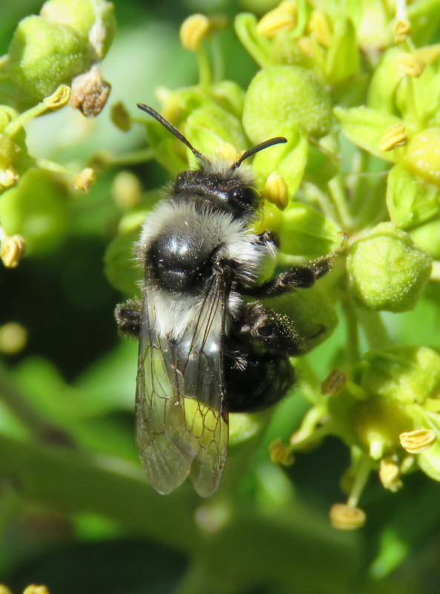
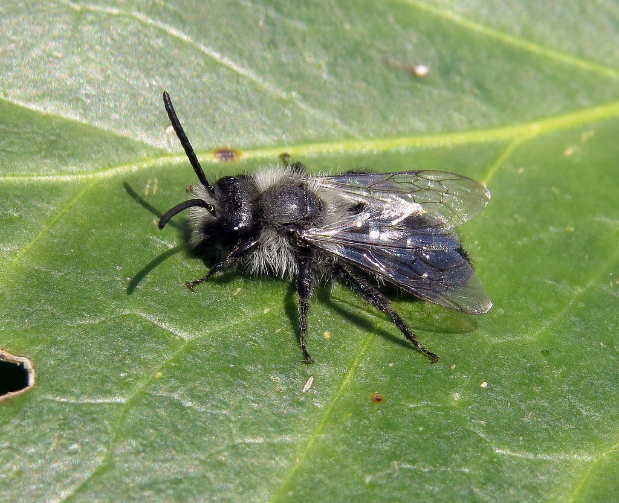
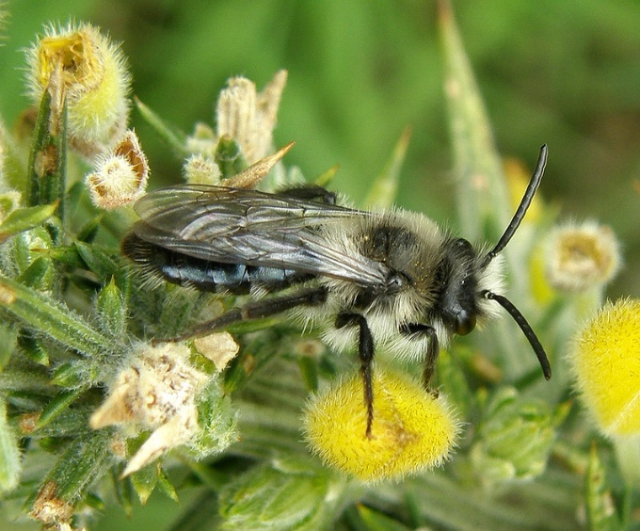
Andrena cineraria - Quiz

Slide 9
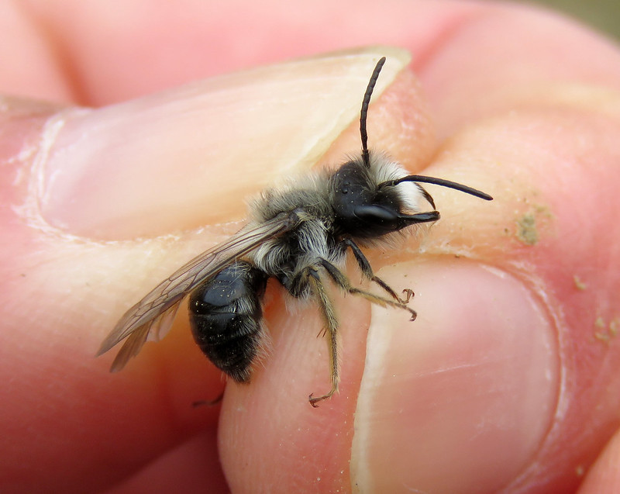
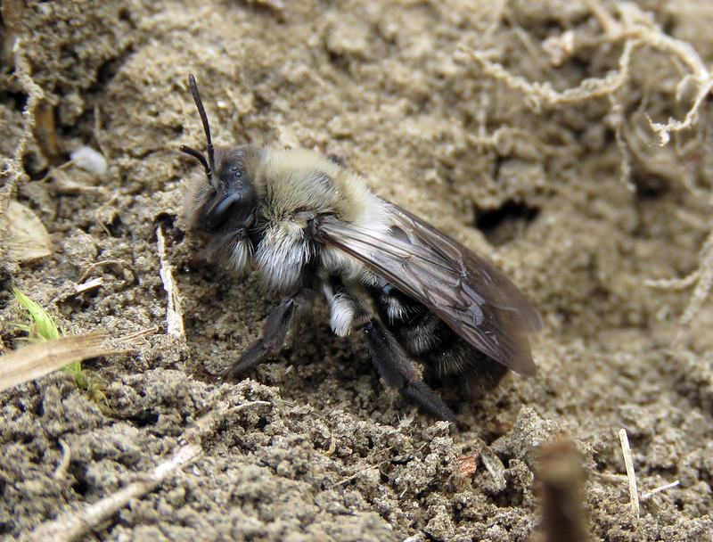
Andrena cineraria - Quiz

Slide 10
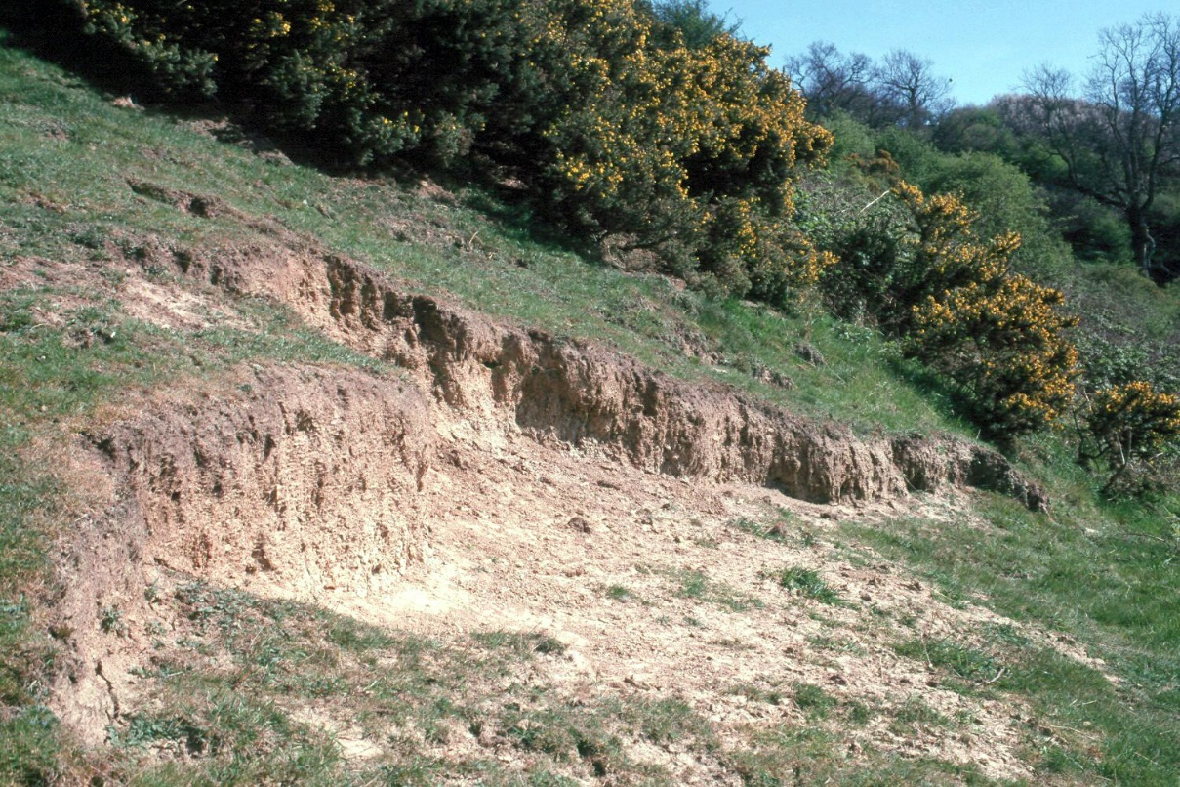
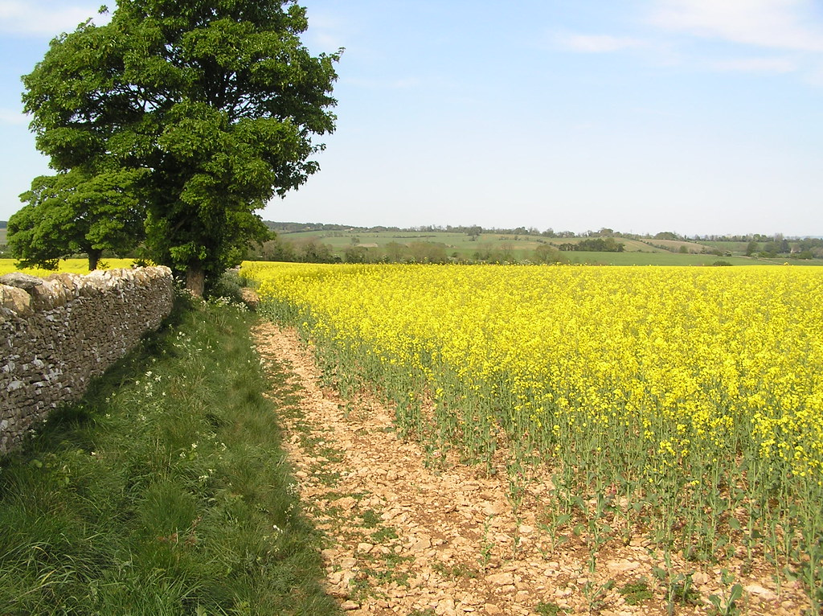
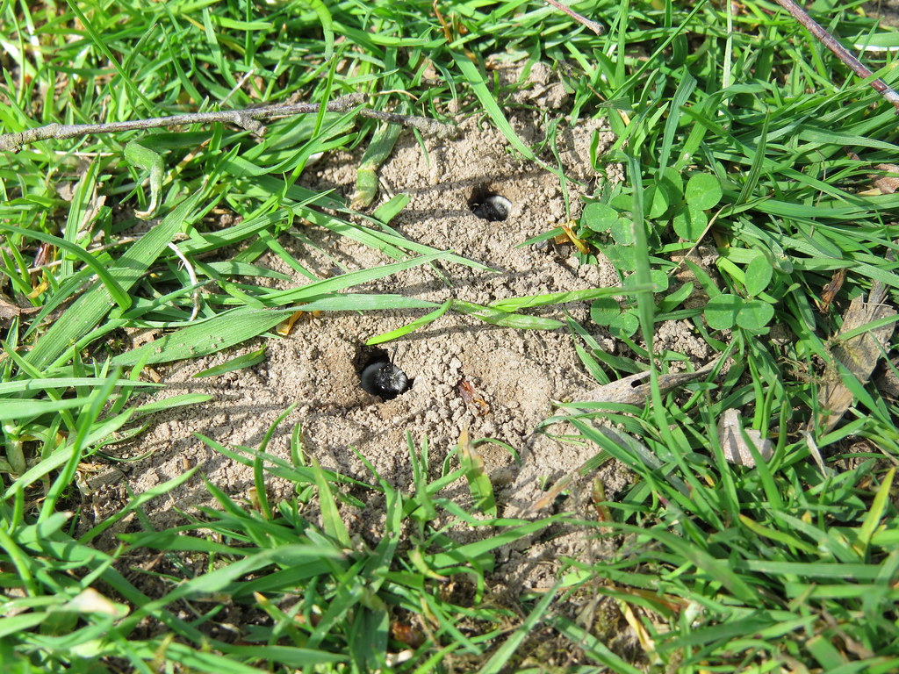
Andrena - Where to find them?

Slide 11
Osmia– Summary
Males:
No horns
Light-colored facial hairs for O. bicornis and white hair for O. cornuta
Longer antennae (almost 2x head width)
No pouch
Usually smaller
Females:
Horns
Black faces
Shorter antennae, barely longer that head width
Pollen pouch/basket on the hind legs

Slide 12
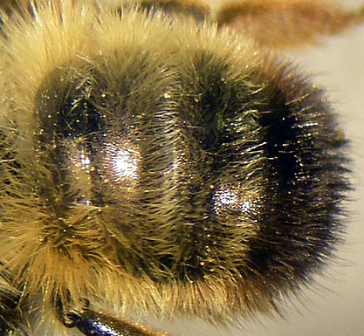
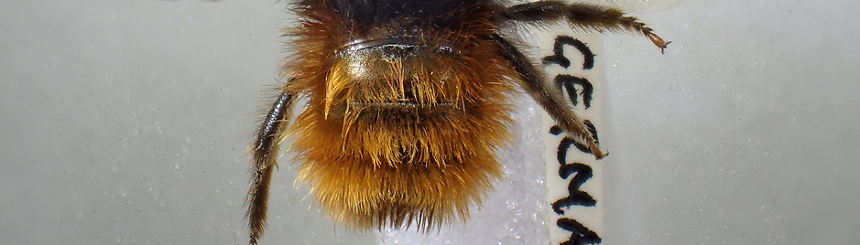
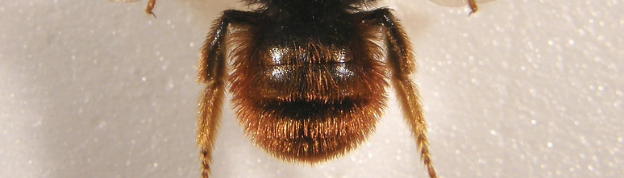
Osmia– Summary
O. bicornis:
Females have greyish, light-colored hair on the dorsal part of the thorax and yellow/orange hair on the abdomen
Black tip at the end of the abdomen
O. cornuta:
Females have a black-haired thorax and their abdomen has a brighter red color
O. bicolor:
Females look like O. cornuta but are smaller(<1cm)
Shorter haired (you see more of the black tergite)
No facial horns
Most often nests in empty snail shells

Slide 13
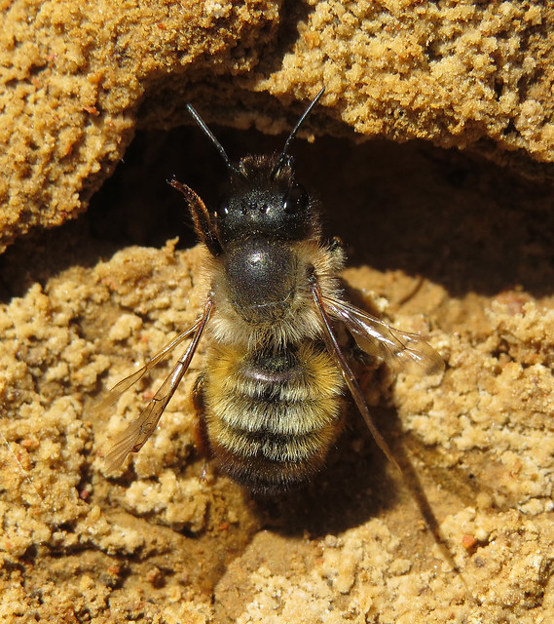
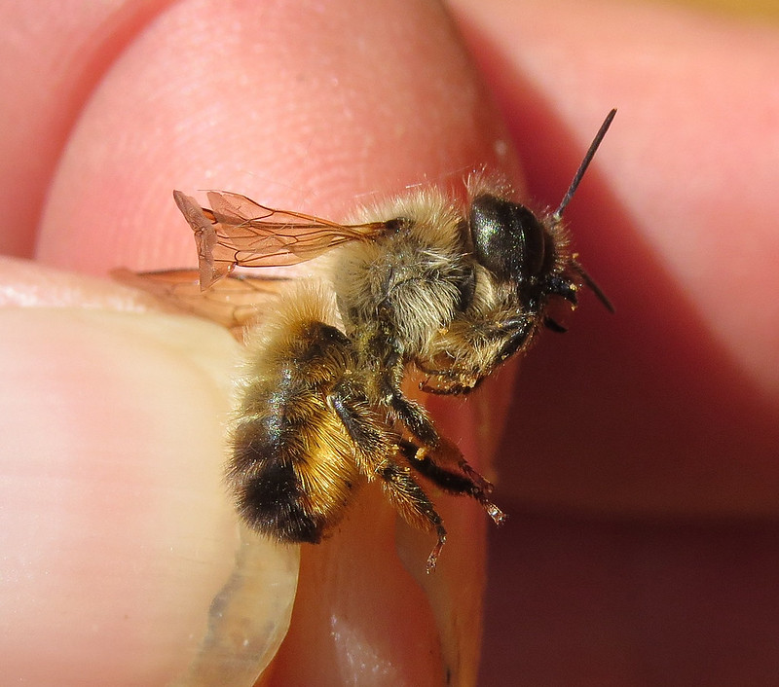
Osmia - Quiz

Slide 14
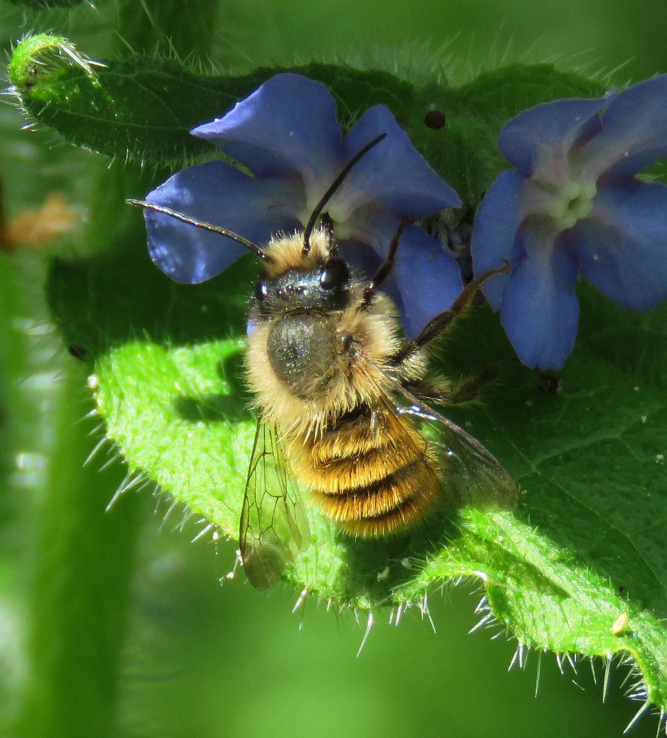
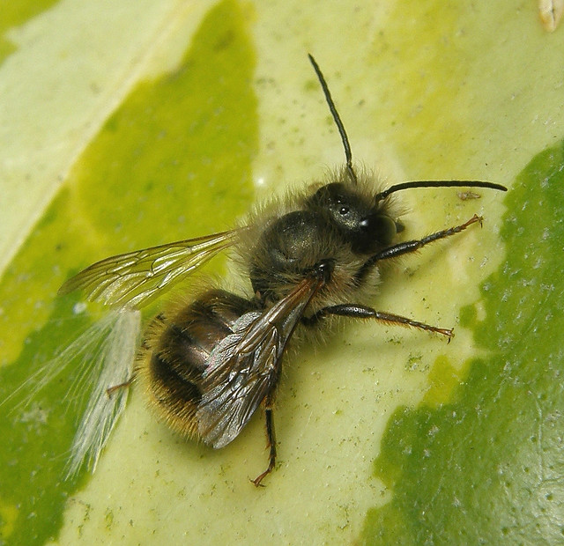
Osmia - Quiz

Slide 15
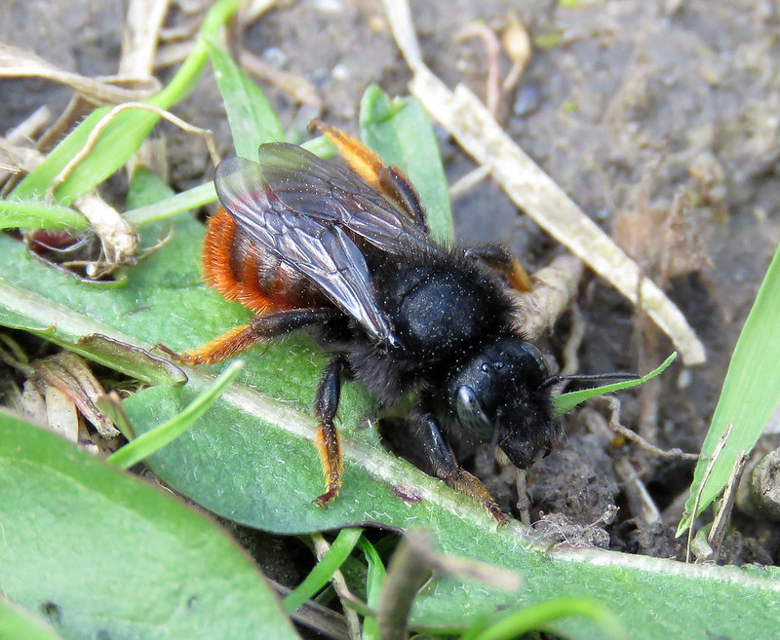
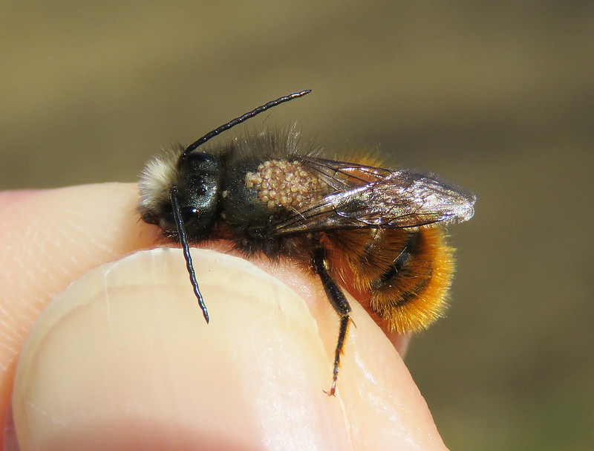
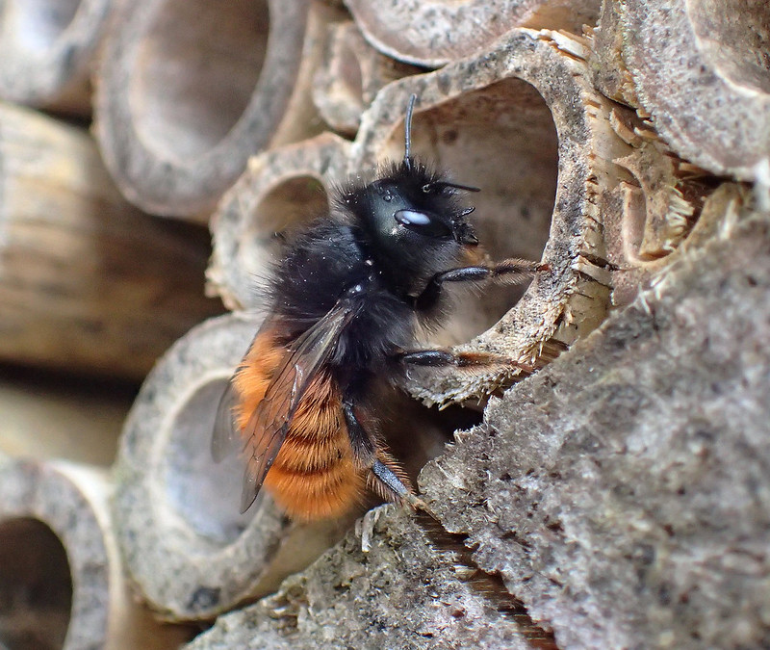
Osmia - Quiz

Slide 16
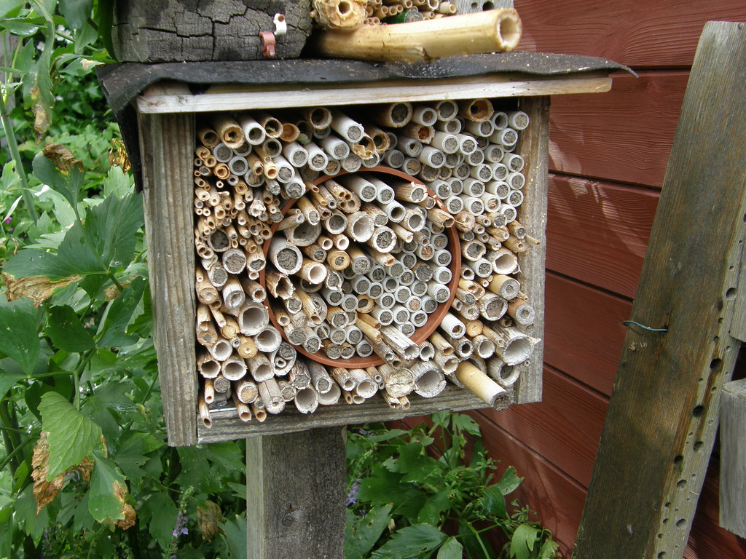
Osmia – Where to find them?
Other spots:
Cracks in walls
Holes in plastering
Drainage pipes
Cracks in window frames
Recesses in stones
Old nests of fur bees
Key holes
Empty snail shells (occasional)
Empty plant stems
Empty beetle hollows
Sandy banks
Old-mortared walls
They need moist soil/mud to close their nests.
Male eggs are laid in front so do not collect cocoons,

Slide 17
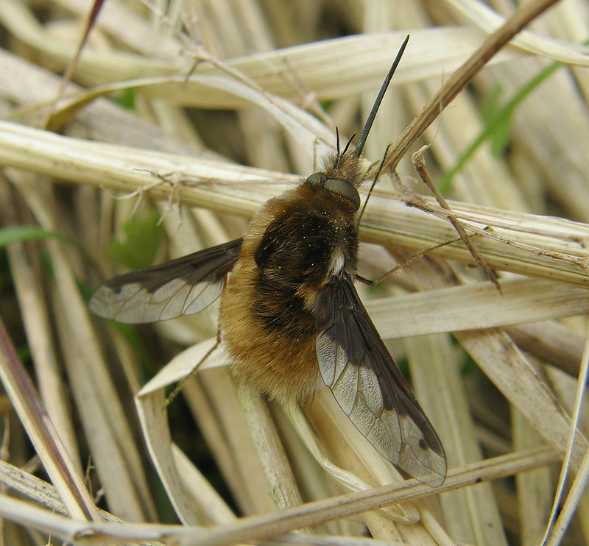
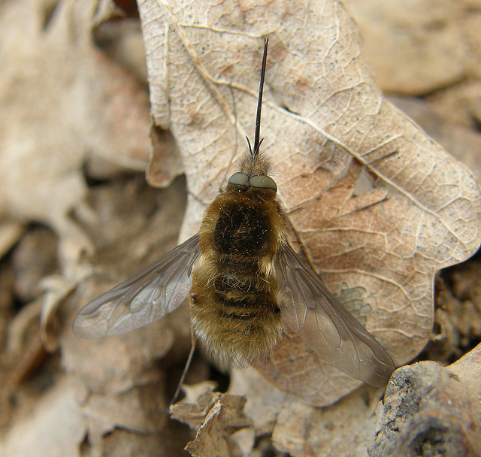
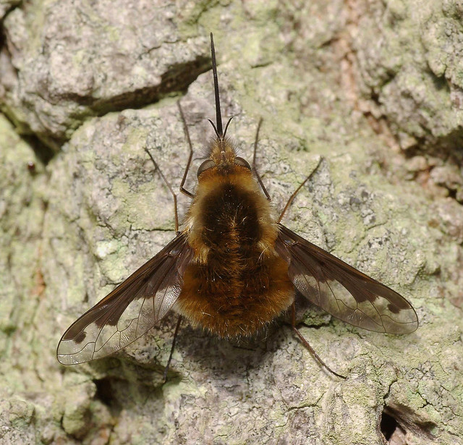
Bombylius major

Slide 18
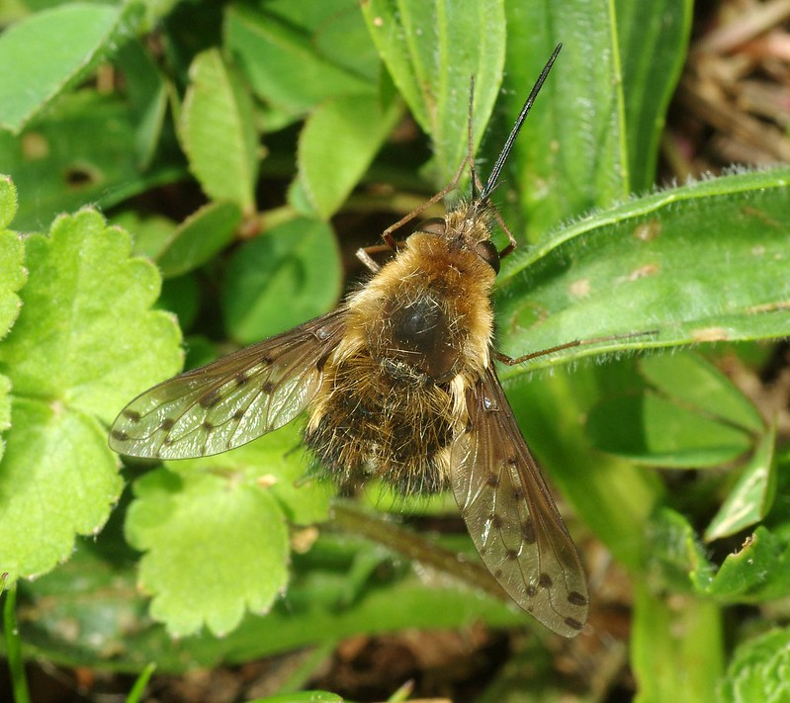
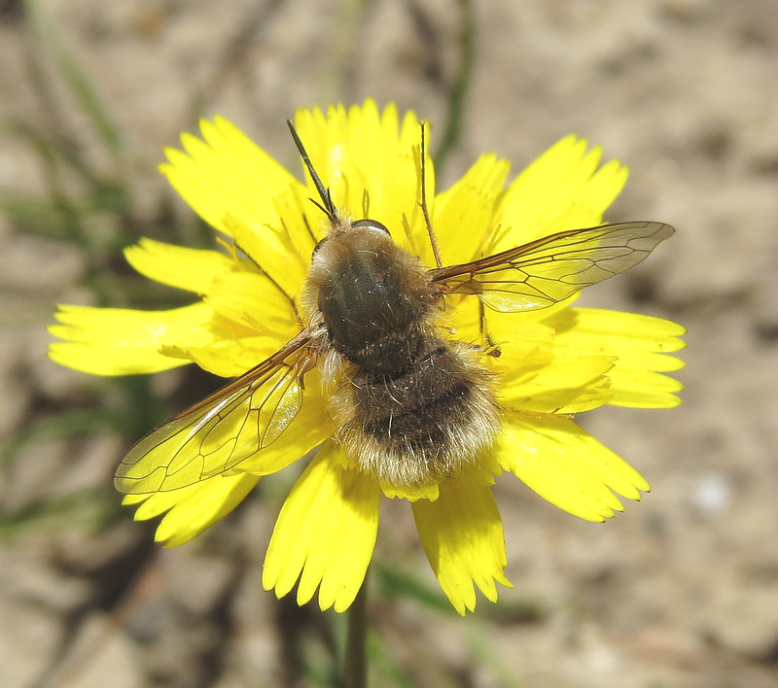
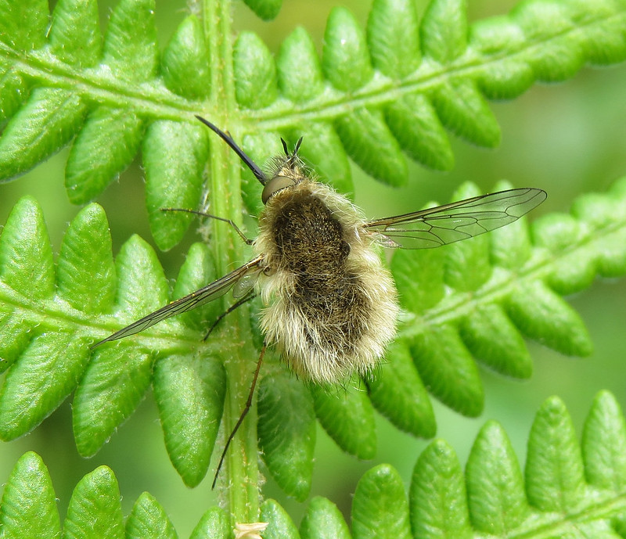
Bombylius major – Potential confusion
Other bee flies have either transparent wings or dotted wings

Slide 19
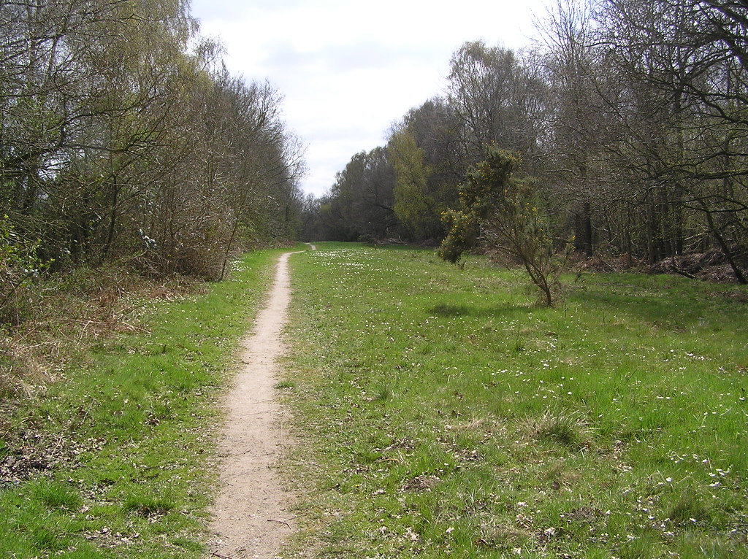
Bombylius major – Where to find them
Adults may bask on dead leaves and bare ground
Males hover above our heads
Can be found close to Andrena sp. nests

Slide 20

Safety on the field
Fieldwork is generally safe.
If you prefer to sample in pairs, especially for remote or sketchy areas, that is totally fine. Try to sample at least 30m from each other when on site.
If your sampling site is close to a road, please wear a high visibility safety vest.
If a guard bothers you without being threatening, call us:
Julian (+33 7 49 68 53 94) and Alain (+352 691 723 102)

Slide 21
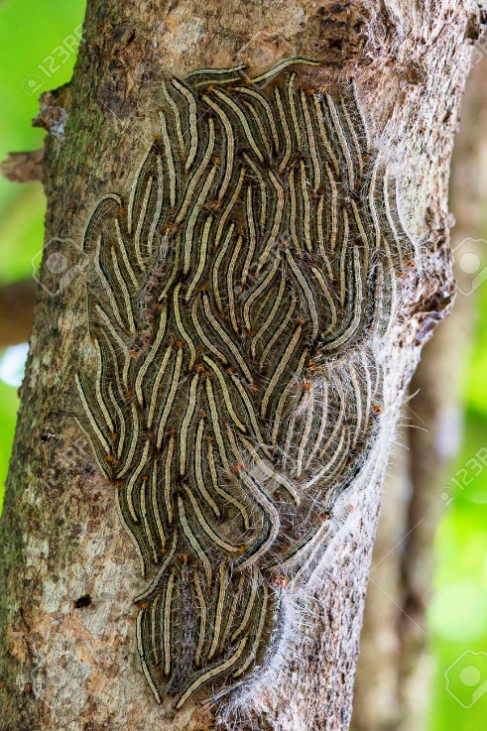
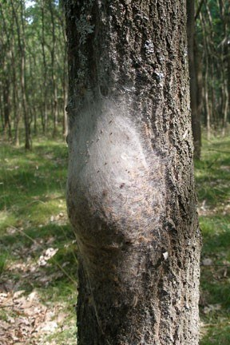
Safety on the field
Be careful about areas infested with oak processionary, avoid them and downwind areas on windy days. Wear pants not shorts if covering forested areas.
Some dogs and horses may become quite nervous because of the net, slowly put the net down until they are gone.
Absolutely avoid eye-contact with stray dogs.

Slide 22
Interactions with the public
People may be more upset about us collecting bees than flies.
Learn a quick project description that you can recite to people asking you what you are doing. It may seem superfluous but this will help you appear more assertive and trustworthy when explaining the project. If you can, prepare it in two or more languages.
Example:
“We are collecting bees and flies in order to learn more about how urbanisation/the landscape affects pollinators. This will help us protect them in the long term. The species we are collecting are very common, are not threatened, and we only collect a few per squared kilometre so no need to worry.”
You will need to ring people’s doorbells if they have a nice garden in a cell you have not covered yet. Don’t forget to look out for bee hotels!

Slide 23
Data entry and Field work organisation
Book your cells and enter your success (can be inexact) here:
https://docs.google.com/spreadsheets/d/1hifgIF_Yw765mo0xqFZNHAfZ0U6C9fA46Bmeriz1Xe4/edit#gid=0
Fill the metadata (must be exact!!) here:
https://docs.google.com/spreadsheets/d/14iU8YXKV3l5ENuRBTa8Q4Us8zm-KmGJBrGhFSpKhtwY/edit?usp=sharing
I sent you the maps by email (open them with Firefox Mozilla)

